Slide 1


Cartilage
Dr. Mahdi H. Hammadi
PhD Sc. Clinical Physiology

Slide 2
Cartilage is a flexible connective tissue
a rubber-like padding that covers and protects the ends of long bones at the joints,
is a structural component of the rib cage, the ear, the nose, the bronchial tubes, the intervertebral discs, and many other body components.
It is not as hard and rigid as bone
But it is much stiffer and much less flexible than muscle

Slide 3
Cartilage is classified in three types:
Elastic cartilage
Hyaline cartilage
Fibrocartilage

Slide 4
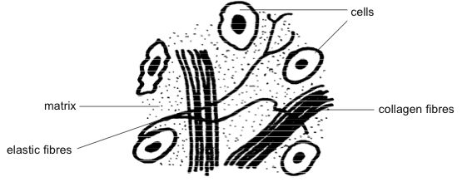

Slide 5
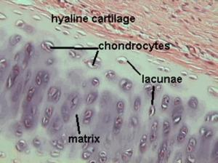

Slide 6
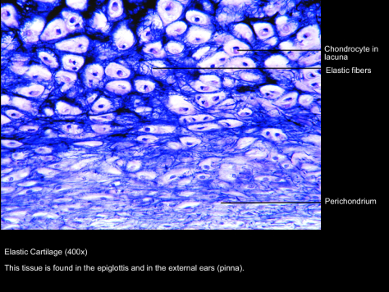
Elastic cartilage

Slide 7
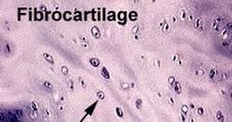
Fibrocartilage

Slide 8
Articular cartilage
The articular cartilage function is dependent on the molecular composition of the extracellular matrix (ECM).
The ECM consists mainly of proteoglycan and collagens.
The main proteoglycan in cartilage is aggrecan,

Slide 9
Function

Slide 10
Repair
Once damaged, cartilage has limited repair capabilities because chondrocytes are bound in lacunae and cannot migrate to damaged areas. Also, because cartilage does not have a blood supply, the deposition of new matrix is slow.
Damaged hyaline cartilage is usually replaced by fibrocartilage

